Slide 1
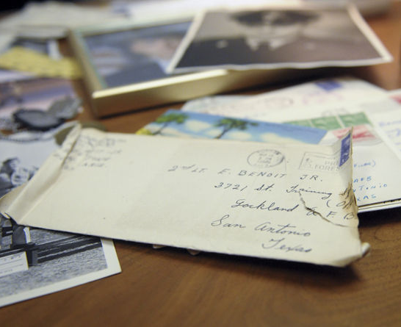

Dispatches from the Front
Findings of the Virtual Footlocker Project Phase 1
Edward Benoit, III & Roxanne Guidry

Slide 2
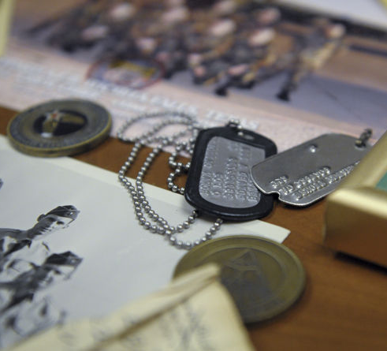
Background
Research Questions
What types of communication and documentary methods are modern soldiers using?
What, if any, methods are modern soldiers using to preserve their service-time archives and records (and to what degree)?
Methodology
Notes:
Methodology
Qualtrics-based survey
Recruitment by Qualtrics panels
180 respondents, 14 invalidated
Questions simplified from previous survey
Descriptive statistics and open-coding

Slide 3
Participant Demographics (n=166)
25%/75% Officer/Enlisted
54% born in 1982 or later
64%/36% Male/Female
Race
White 79%
Black 11%
Lantinx 13%
American Indian 1%
Asian/Indian 7%
Notes:
Officer: 76% O-4 or below
Enlisted: 79% E-5 or below

Slide 4
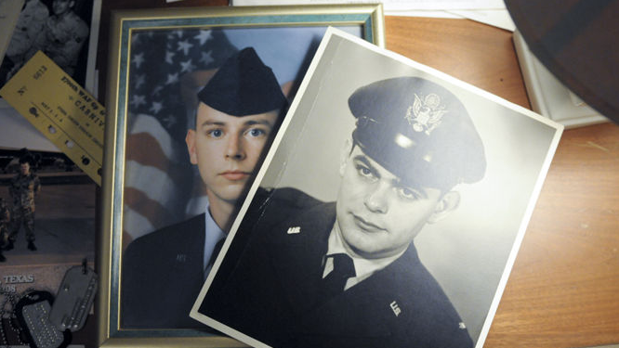
Results

Slide 5
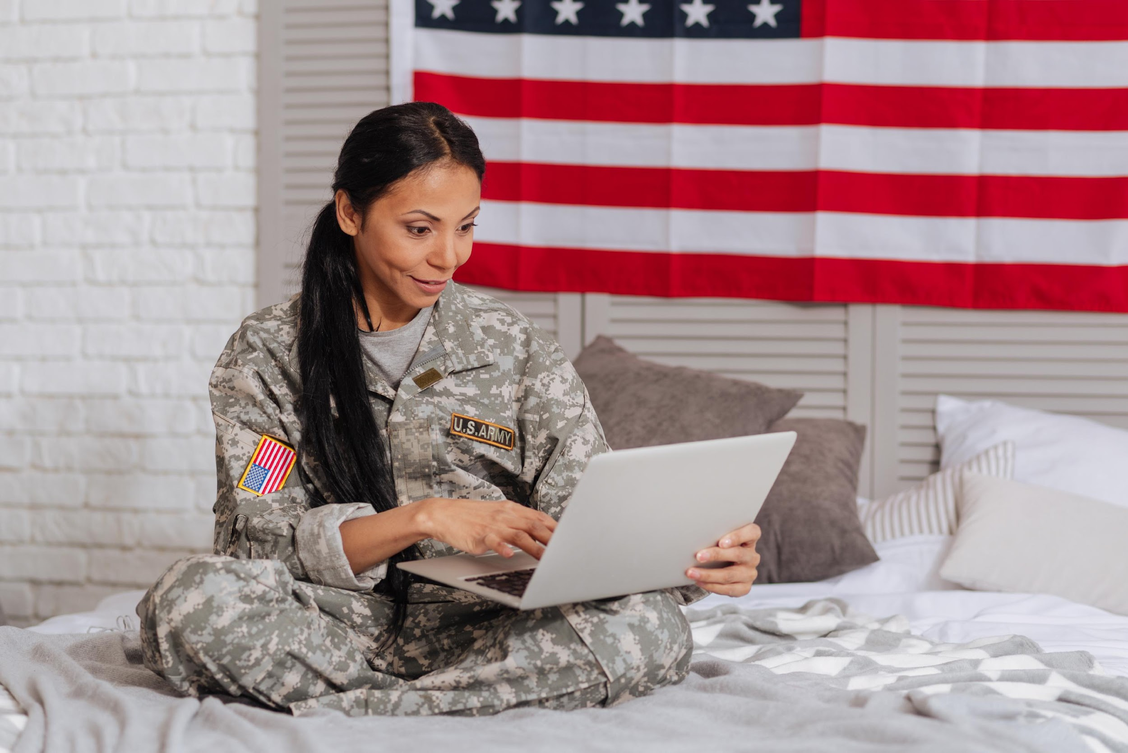
Communication Methods & Techniques
Different communication methods for family vs friends
Methods change during deployment in all categories

Slide 7
Notes:
Web-based email rankings:
Gmail 86%
Yahoo 40%
Outlook 25%
Hotmail 21%
AOL 10%

Slide 8
Notes:
Likert Scale:
1 = Never
2= Less than once per month
3 = Once a month
4 = 2-3 times per month
5 = once a week
6 = 2-3 times a week
7 = daily

Slide 9
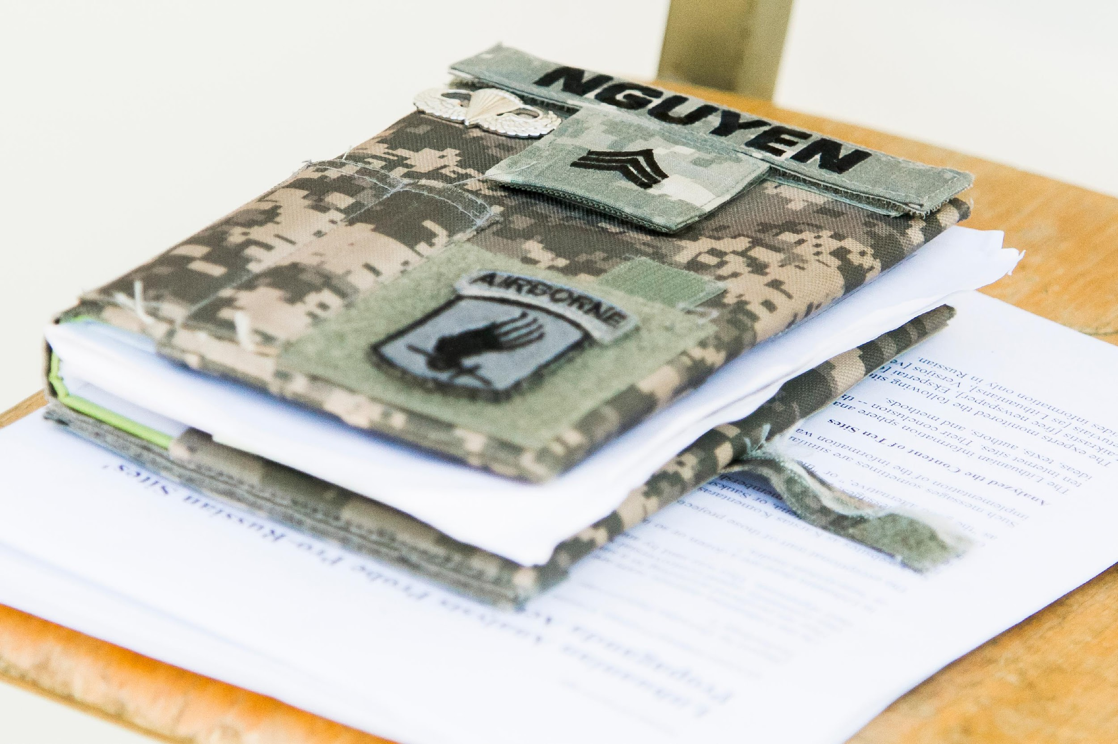
Blogging & Journaling
Majority of respondents do not keep any kind of journal​
Deployed (63.9%), Not Deployed (62.7)​
Offline journals are preferable to online formats. ​
Physical journals are favored over computer files.​
The responses change little based on deployment status.

Slide 10
Notes:
Most respondents did not keep any form of journal, and those that did keep them used offline formats.

Slide 11
Notes:
A significantly larger percentage of respondents preferred to use a physical journal over a computer file. Whether they kept a journal or not does change much when they are or are not
Deployed, and then we see a decline in the use of computer files in favor of physical journals.

Slide 12
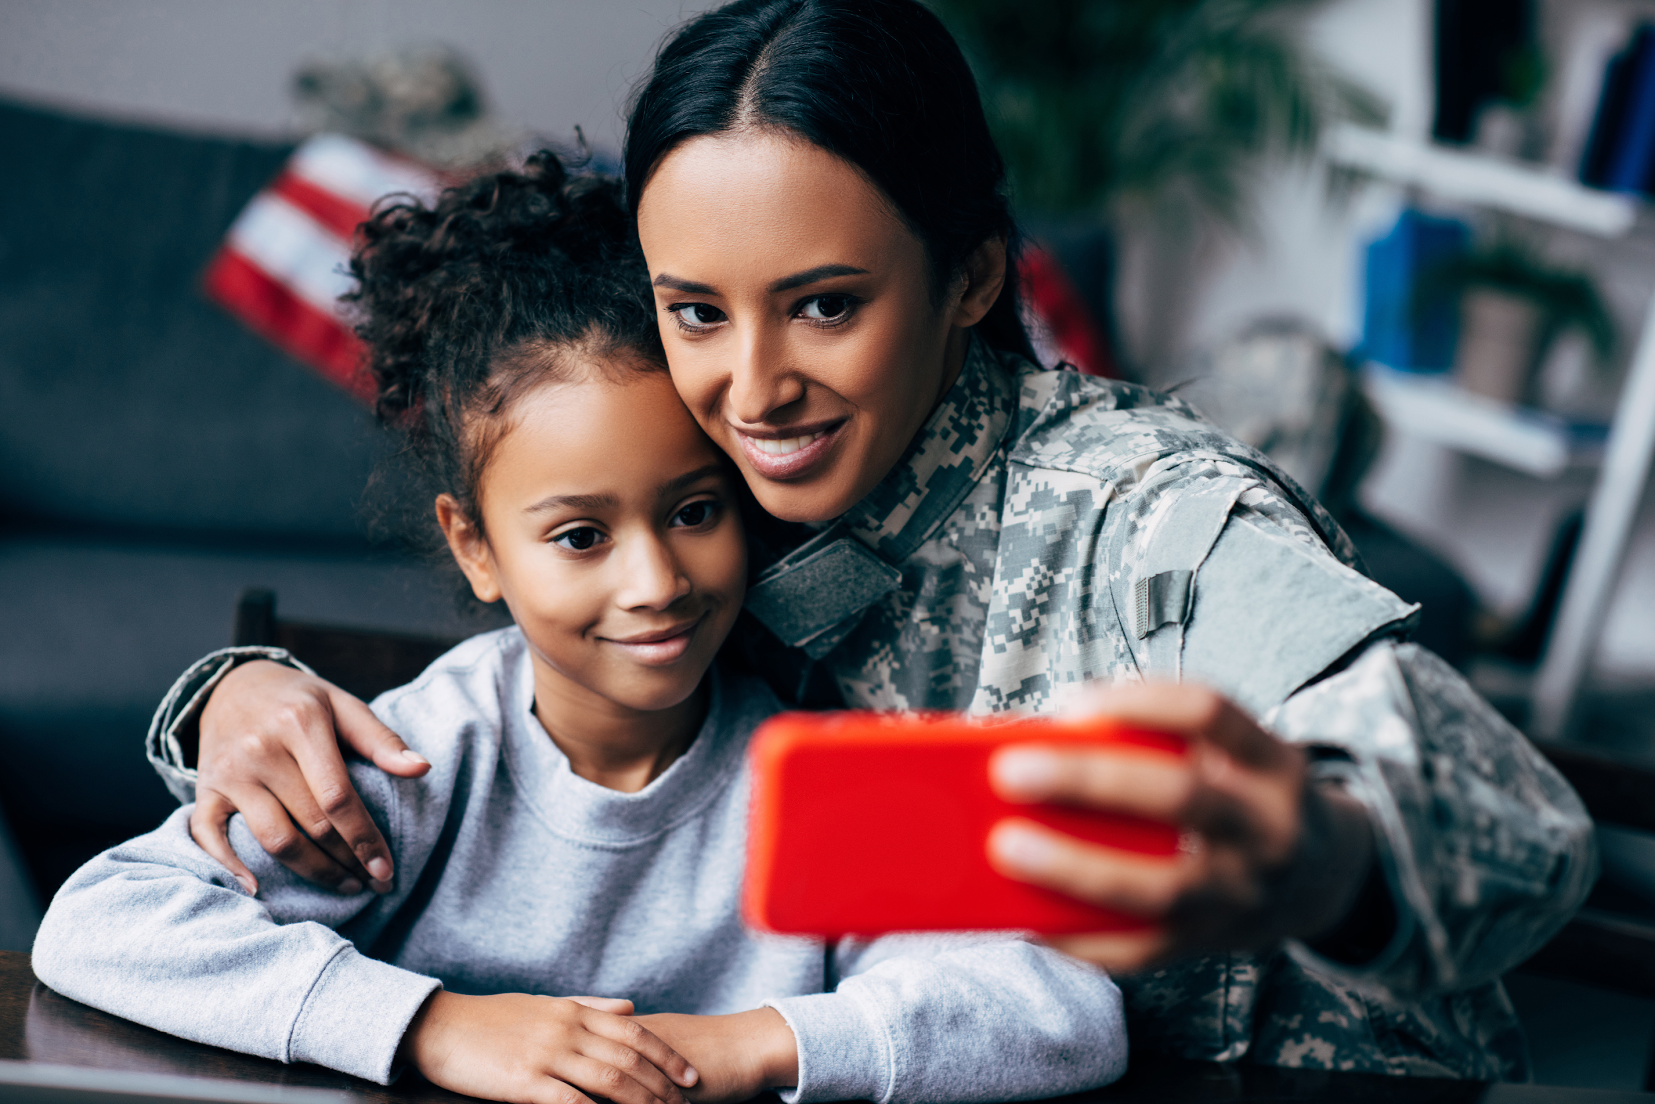
Device vs Cloud Storage: Photographs
When not deployed, majority (74.1%) of participants take digital photos of their military experiences. ​
The same is true of deployed soldiers (62%)​
When deployed, cloud storage is used more than mobile phones or hard drive.
Likert Scale (1= Never, 5=Always)
Non-Deployed n=123, Deployed n=103
Mobile Phone Storage: N/D 3.75, D 3.33
Hard Drive: N/D 3.20, D 2.87
Cloud Storage: N/D 3.59, D 3.36

Slide 16
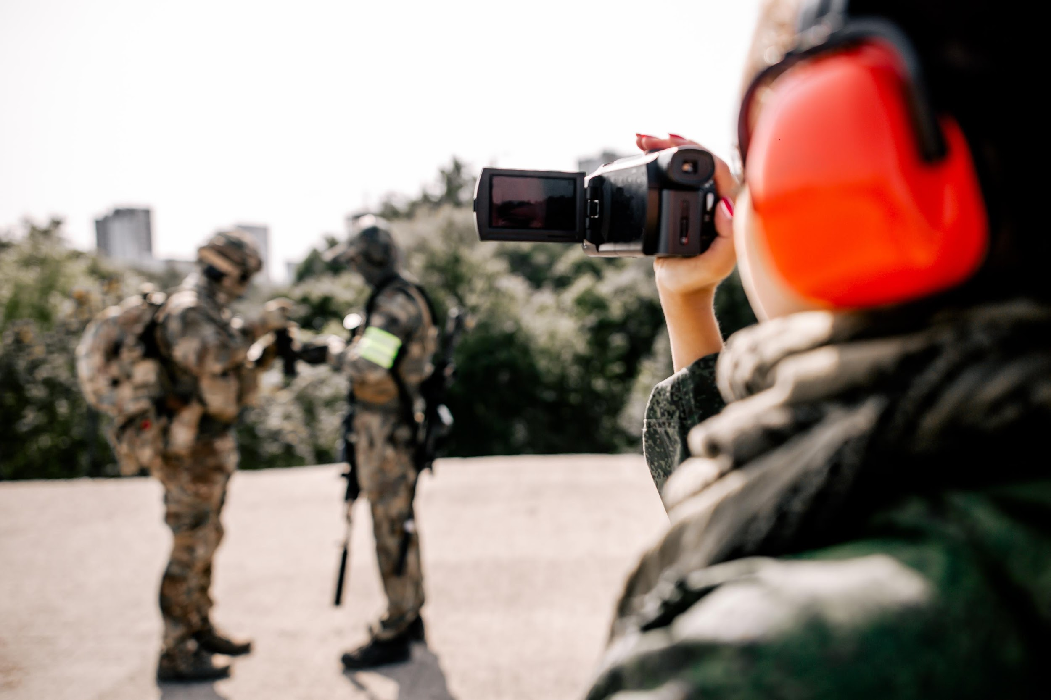
Device vs Cloud Storage: Videos
Fewer soldiers take video of their military experiences (56.6%). ​
This number drops for deployed soldiers (47.6%). ​
Mobile phone and cloud storage remain largely unchanged depending on deployment status. ​
Use of DVD/Blu Ray as video storage decreases among deployed soldiers. ​
Slight increase in hard drive storage among deployed soldiers.
Likert Scale (1= Never, 5=Always); Non-Deployed n=94, Deployed n=79
DVD/Bluray: N/D 2.35, D 2.49
Mobile Phone Storage: N/D 3.67, D 3.54
Hard Drive: N/D 3.12, D 3.16
Cloud Storage: N/D 3.50, D 3.47

Slide 17
Notes:
Mobile phone use decreases slightly among deployed soldiers.

Slide 18
Notes:
Slight increase in HD use among deployed soldiers.

Slide 19
Notes:
DVD/Blu Ray decreases significantly among deployed soldiers.

Slide 20
Notes:
Cloud storage remains largely the same among deployed and non deployed soldiers.

Slide 21

Thoughts on Preservation (n=166)
Majority found preservation of their records an important issue and would consider using an application to do so.
Participant’s interest in donating to archives is more neutral.
Notes:
In your opinion (and life), how important is the long-term preservation of your military related digital files (social media, photographs, emails, etc.)?
Would you use an online app or software that captures your digital files and preserves them for future access/use?
Would you ever consider donating your digital files to an archive focused on the American military experience?
Is there any aspect/memory of your deployed or non-deployed life that you would like help preserving that was not discussed earlier?
Do you have any additional comments for this study?

Slide 22
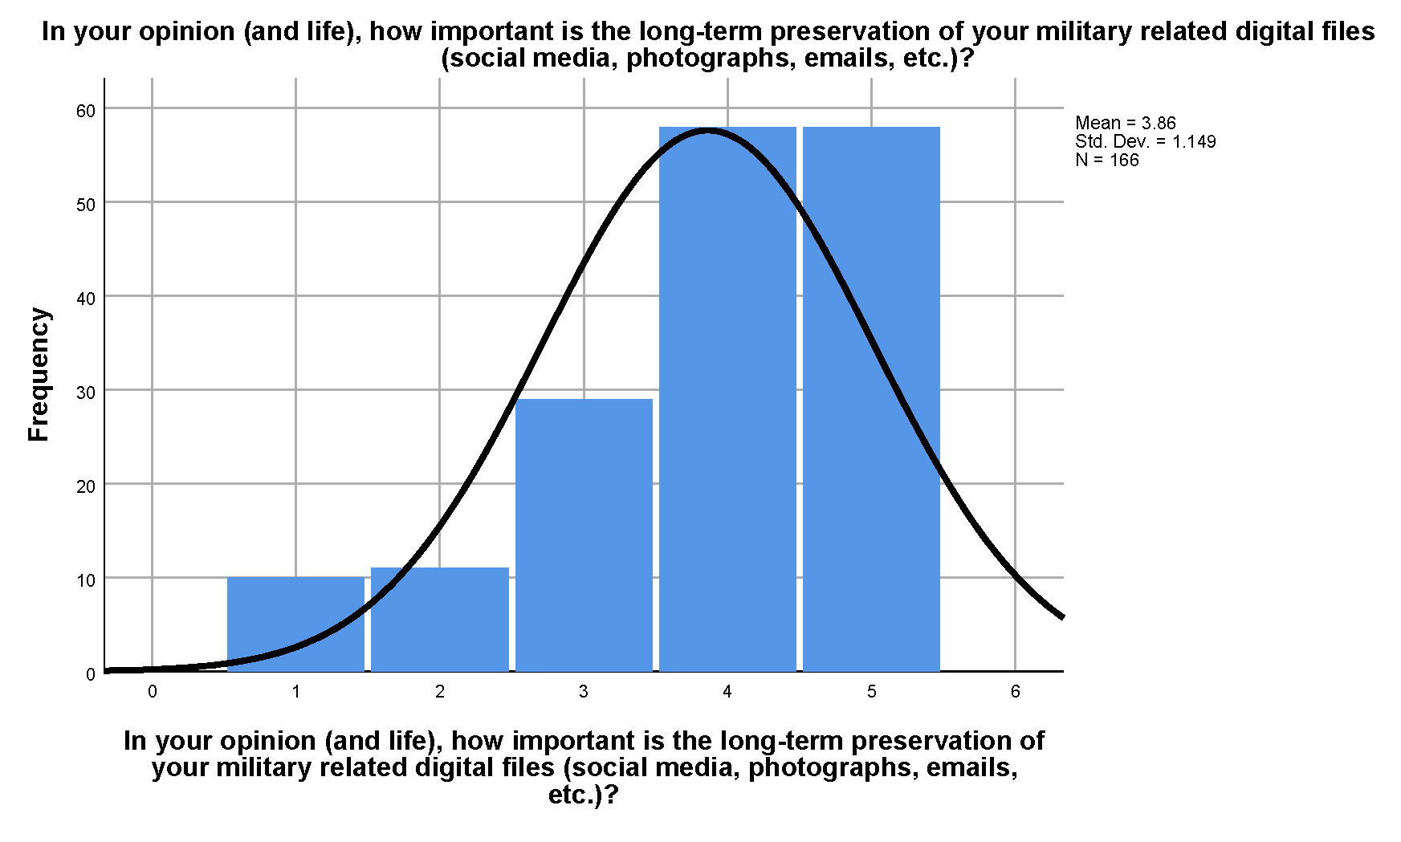
Notes:
Importance of preservation of their records (1= not at all, 5= extremely important) 3.86

Slide 23
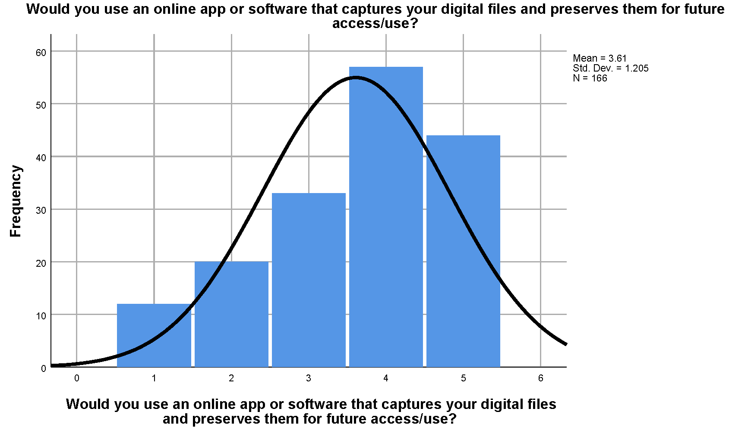
Notes:
Use of a preservation application (1 = def would not, 5 = def would) 3.61

Slide 24
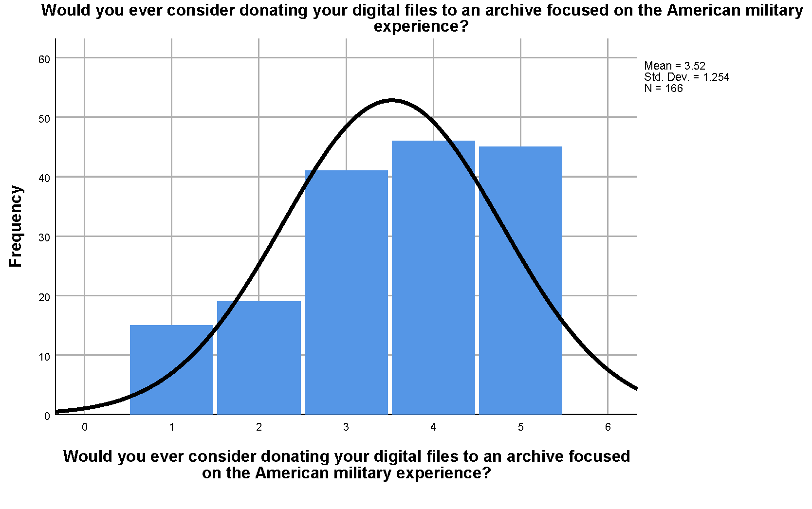
Notes:
Donation of records to archives (1 = def would not, 5 = def would) 3.52

Slide 25
Coded Group | Number | Percent
Public Perception | 6 | 10.5%
Difficult memories | 8 | 14.0%
Family/Personal | 8 | 14.0%
Positive feeling toward the study | 21 | 36.8%
Daily life when deployed | 9 | 15.8%
Concerns | 5 | 8.8%
Open-ended Responses
Public perception
  this would be great to help people understand
  Somewhere where we could show what we saw that others wouldn't get offended or look away they could relate to
Difficult memories
  No. I try to block most of it out.
  Nothing I can think of at this time. I would prefer to forget it but I can’t
Family/Personal
  time with family
  The bond between soldiers
Positive feelings towards the study
          I think this study is very important and helps me remember a very important and scary time in my life
Concerns
  Privacy;
  separate public and private areas
Notes:
Is there any aspect/memory of your deployed or non-deployed life that you would like help preserving that was not discussed earlier?
Do you have any additional comments for this study?
Public perception
this would be great to help people understand
Somewhere where we could show what we saw that others wouldn't get offended or look away they could relate to
Difficult memories
No. I try to block most of it out.
Nothing I can think of at this time. I would prefer to forget it but I can’t
Family/Personal
time with family
The bond between soldiers
Positive feelings towards the study
I think this study is very important and helps me remember a very important and scary time in my life
Concerns
Privacy; separate public and private areas

Slide 26
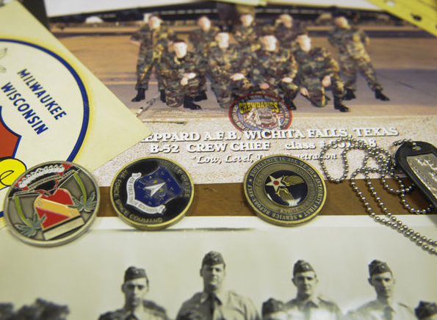
Future Directions
Merging data sets & additional analysis
Phase 2 IMLS Grant

Slide 27

Questions?
Congratulations Roxanne on graduating today!

Slide 28
Questions?

